Slide 2
Operators in Apache Pig

Slide 3
Introduction
It is a high-level procedural language for querying large data sets using Hadoop and the Map Reduce Platform.
It is a Java package, where the scripts can be executed from any language implementation running on the JVM.
It simplifies the use of Hadoop by allowing SQL-like queries to a distributed dataset
It backs many relational features like Join, Group and Aggregate.
it does have many features common with ETL tools.

Slide 4

What is Apache Pig Latin?

Slide 5
Apache Pig Execution Modes
Apache Pig has two execution modes:
Local Mode
MapReduce Mode

Slide 6
Local Mode

Slide 7
MapReduce Mode

Slide 8
Apache Pig Operators

Slide 9
Apache Pig Operators
The first file contain three fields:
user
url
& id

Slide 10
Apache Pig Operators
The second file contain two fields
url
& rating
.

Slide 11
Classification of Apache Pig operators
The Apache Pig operators can be classified as:
Relational
and Diagnostic

Slide 12
Relational Operators:

Slide 13
Load Operators:
LOAD operator is used to load data from the file system or HDFS storage into a Pig relation.
The field names are
user,
url,
id.

Slide 14
Load Operators:

Slide 15
Foreach

Slide 16
Foreach

Slide 17
Filter

Slide 18
Filter

Slide 19
Join
JOIN operator is used to perform an inner, equijoin join of two or more relations based on common field values.
The JOIN operator always performs an inner join.
Inner joins ignore null keys, so it makes sense to filter them out before the join.

Slide 20
Order By

Slide 21
Order By

Slide 22
Distinct

Slide 23
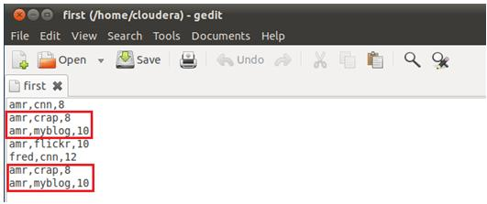
Distinct

Slide 24
Store

Slide 25
Store

